Slide 1
Scatterplots & Correlation

Slide 2
Learning Targets
Distinguish between explanatory and response variables for quantitative data.
Make a scatterplot to display the relationship between two quantitative variables.
Describe the direction, form, and strength of a relationship displayed in a scatterplot and identify unusual features.
Interpret the correlation.
Understand the basic properties of correlation, including how the correlation is influenced by outliers.
Distinguish correlation from causation.

Slide 3
Topics
Explanatory and response variable
Describing scatterplots
The correlation coefficient (r)
Correlation and causation

Slide 4
Topics
Explanatory and response variable
Describing scatterplots
The correlation coefficient (r)
Correlation and causation

Slide 5
Bivariate Data
Bivariate data: data with two variables
Two quantitative variables are visualized in a scatterplot.

Slide 6
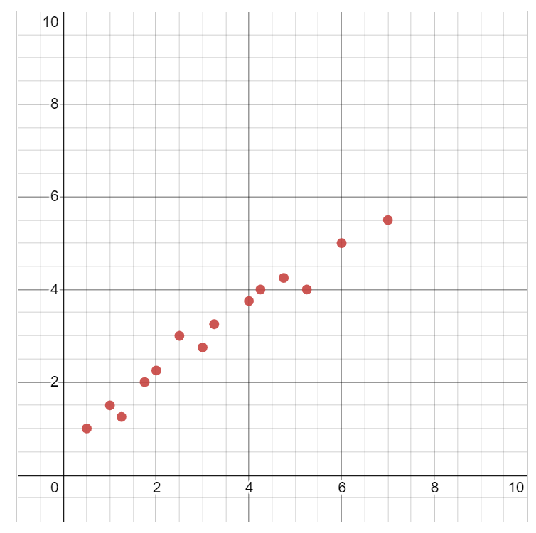
When we have bivariate data (data with two quantitative variables), we can express that data in a scatterplot, as shown on the graph.
Hypothesize：What are two possible categories that could have data/results like are shown in the scatterplot to the left?
Be creative!
Notes:
注意x和y差不多是1:1的比例，y比x稍微小一点
"number of bedrooms in a house to number of members of a family" (--> but wait why are there decimal values?)
"number of hours spent in class to number of hours of homework" etc.
See if students themselves can start to describe characteristics of a positive correlation here...
这个就是正相关

Slide 7
Using this data from San Antonio, TX, we will explore whether there is a relationship between neighborhood income and access to organic items at local grocery stores.
Zip Code | Store Location | Average Household Income | Number of Organic Vegetables Offered
78204 | South Flores | $71,186 | 36
78207 | N. Rosillo st | $34,234 | 4
78204 | Nogalitos st | $71,186 | 28
78201 | Frederickburg rd | $48,760 | 31
78212 | Olmos | $78,096 | 78
78202 | N New Braunfels | $40,506 | 14
78237 | Castroville | $38,166 | 12
78228 | Culebra rd | $50,398 | 18
78227 | Marbach rd | $49,437 | 38
78240 | Babcock rd | $66,073 | 84
78230 | Wurzbach rd | $86,566 | 61
78251 | W Loop 1604 N | $78,176 | 56
Notes:
更全的数据请见handout
什么是自变量什么是因变量？

Slide 8
Explanatory and Response Variables
Explanatory (independent) variable: the variable that predicts, explains, or influences a trend in the response variable. This is the x-variable.

Slide 9
Explanatory and Response Variables
Explanatory (independent) variable: the variable that predicts, explains, or influences a trend in the response variable. This is the x-variable.
Response (dependent) variable: the measured outcome. Responds to trends in the explanatory variable. This is the
y-variable.

Slide 10
Explanatory and Response Variables
It is easiest to identify explanatory and response variables when we initially specify the values of one variable to see how it affects another variable.
For instance, to study the effect of alcohol on body temperature, researchers gave several different amounts of alcohol to mice. Then they measured the change in each mouse’s body temperature 15 minutes later. In this case, amount of alcohol is the explanatory variable, and change in body temperature is the response variable. When we don’t specify the values of either variable before collecting the data, there may or may not be a clear explanatory variable.

Slide 11
Explanatory and Response Variables
Average Household Income | Organic Vegetables Offered
$71,186 | 36
$34,234 | 4
$71,186 | 28
$48,760 | 31
$78,096 | 78
$40,506 | 14
$38,166 | 12
$50,398 | 18
$49,437 | 38
$66,073 | 84
$86,566 | 61
$78,176 | 56
Explanatory (independent) variable: the variable that predicts, explains, or influences a trend in the response variable. This is the x-variable.
Response (dependent) variable: the measured outcome. Responds to trends in the explanatory variable. This is the
y-variable.

Slide 12
Explanatory and Response Variables
explains
responds
Average Household Income | Organic Vegetables Offered
$71,186 | 36
$34,234 | 4
$71,186 | 28
$48,760 | 31
$78,096 | 78
$40,506 | 14
$38,166 | 12
$50,398 | 18
$49,437 | 38
$66,073 | 84
$86,566 | 61
$78,176 | 56
Explanatory (independent) variable: the variable that predicts, explains, or influences a trend in the response variable. This is the x-variable.
Response (dependent) variable: the measured outcome. Responds to trends in the explanatory variable. This is the
y-variable.

Slide 13
Explanatory and Response Variables
explains
responds
Average Household Income (x) | Organic Vegetables Offered
$71,186 | 36
$34,234 | 4
$71,186 | 28
$48,760 | 31
$78,096 | 78
$40,506 | 14
$38,166 | 12
$50,398 | 18
$49,437 | 38
$66,073 | 84
$86,566 | 61
$78,176 | 56
Explanatory (independent) variable: the variable that predicts, explains, or influences a trend in the response variable. This is the x-variable.
Response (dependent) variable: the measured outcome. Responds to trends in the explanatory variable. This is the
y-variable.

Slide 14
Explanatory and Response Variables
explains
responds
Average Household Income (x) | Organic Vegetables Offered (y)
$71,186 | 36
$34,234 | 4
$71,186 | 28
$48,760 | 31
$78,096 | 78
$40,506 | 14
$38,166 | 12
$50,398 | 18
$49,437 | 38
$66,073 | 84
$86,566 | 61
$78,176 | 56
Explanatory (independent) variable: the variable that predicts, explains, or influences a trend in the response variable. This is the x-variable.
Response (dependent) variable: the measured outcome. Responds to trends in the explanatory variable. This is the
y-variable.

Slide 15
Topics
Explanatory and response variable
Describing scatterplots
The correlation coefficient (r)
Correlation and causation

Slide 16
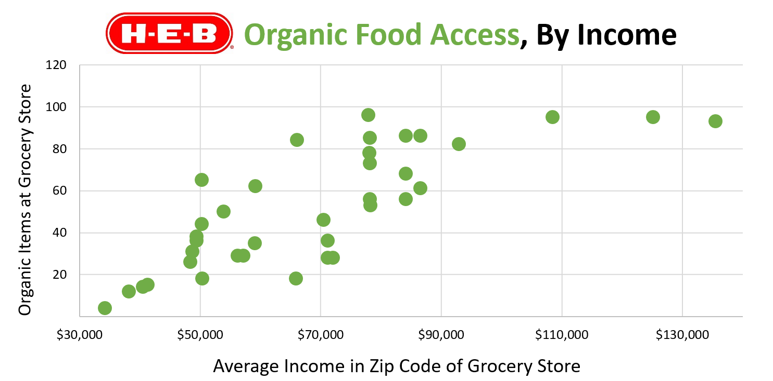
Scatterplot
Notes:
不用从0开始画（坐标轴） 要有title xy坐标轴的说明以及数字+单位

Slide 17
Describing Scatterplots
Correlation: measures how two variables are related.

Slide 18
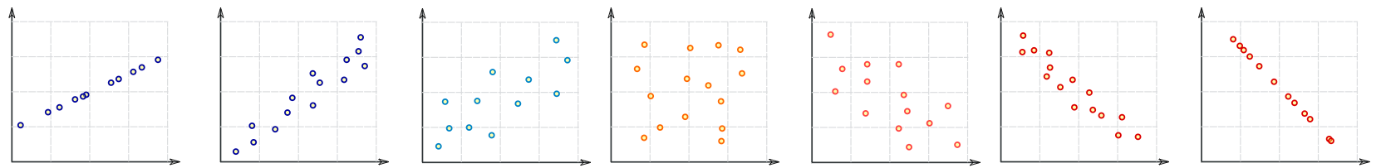
Describing Scatterplots
Graphic inspired by mathisfun.com
Perfect Positive Correlation
Strong Positive Correlation
Weak Positive Correlation
Weak Negative Correlation
Strong Negative Correlation
Perfect Negative Correlation
No
Correlation

Slide 19
Describing Scatterplots
Graphic inspired by mathisfun.com
Perfect Positive Correlation
Strong Positive Correlation
Weak Positive Correlation
Weak Negative Correlation
Strong Negative Correlation
Perfect Negative Correlation
No
Correlation
Positive correlations: as the x values increase, the y values also tend to increase.

Slide 20
Describing Scatterplots
Graphic inspired by mathisfun.com
Perfect Positive Correlation
Strong Positive Correlation
Weak Positive Correlation
Weak Negative Correlation
Strong Negative Correlation
Perfect Negative Correlation
No
Correlation
x increases
Positive correlations: as the x values increase, the y values also tend to increase.

Slide 21
Describing Scatterplots
Graphic inspired by mathisfun.com
Perfect Positive Correlation
Strong Positive Correlation
Weak Positive Correlation
Weak Negative Correlation
Strong Negative Correlation
Perfect Negative Correlation
No
Correlation
y
x increases
Positive correlations: as the x values increase, the y values also tend to increase.

Slide 22
Describing Scatterplots
Graphic inspired by mathisfun.com
Perfect Positive Correlation
Strong Positive Correlation
Weak Positive Correlation
Weak Negative Correlation
Strong Negative Correlation
Perfect Negative Correlation
No
Correlation
y
y
y
x increases
x increases
x increases
Positive correlations: as the x values increase, the y values also tend to increase.

Slide 23
Describing Scatterplots
Graphic inspired by mathisfun.com
Perfect Positive Correlation
Strong Positive Correlation
Weak Positive Correlation
Weak Negative Correlation
Strong Negative Correlation
Perfect Negative Correlation
No
Correlation
y
y
y
x increases
x increases
x increases
Positive correlations: as the x values increase, the y values also tend to increase.
Negative correlations: as the x values increase, the y values tend to decrease.

Slide 24
Describing Scatterplots
Graphic inspired by mathisfun.com
Perfect Positive Correlation
Strong Positive Correlation
Weak Positive Correlation
Weak Negative Correlation
Strong Negative Correlation
Perfect Negative Correlation
No
Correlation
x increases
y
y
y
x increases
x increases
x increases
Positive correlations: as the x values increase, the y values also tend to increase.
Negative correlations: as the x values increase, the y values tend to decrease.

Slide 25
Describing Scatterplots
Graphic inspired by mathisfun.com
Perfect Positive Correlation
Strong Positive Correlation
Weak Positive Correlation
Weak Negative Correlation
Strong Negative Correlation
Perfect Negative Correlation
No
Correlation
x increases
y
y
y
y
x increases
x increases
x increases
Positive correlations: as the x values increase, the y values also tend to increase.
Negative correlations: as the x values increase, the y values tend to decrease.

Slide 26
Describing Scatterplots
Graphic inspired by mathisfun.com
Perfect Positive Correlation
Strong Positive Correlation
Weak Positive Correlation
Weak Negative Correlation
Strong Negative Correlation
Perfect Negative Correlation
No
Correlation
x increases
x increases
x increases
y
y
y
y
y
y
x increases
x increases
x increases
Positive correlations: as the x values increase, the y values also tend to increase.
Negative correlations: as the x values increase, the y values tend to decrease.

Slide 27
Describing Scatterplots
Graphic inspired by mathisfun.com
Perfect Positive Correlation
Strong Positive Correlation
Weak Positive Correlation
Weak Negative Correlation
Strong Negative Correlation
Perfect Negative Correlation
No
Correlation
x increases
x increases
x increases
y
y
y
y
y
y
x increases
x increases
x increases
Positive correlations: as the x values increase, the y values also tend to increase.
Negative correlations: as the x values increase, the y values tend to decrease.
Notes:
Positive correlation： positive slope

Slide 28
Describing Scatterplots
Graphic inspired by mathisfun.com
Perfect Positive Correlation
Strong Positive Correlation
Weak Positive Correlation
Weak Negative Correlation
Strong Negative Correlation
Perfect Negative Correlation
No
Correlation
(+)
(+)
(+)
x increases
x increases
x increases
y
y
y
y
y
y
x increases
x increases
x increases
Positive correlations: as the x values increase, the y values also tend to increase.
Negative correlations: as the x values increase, the y values tend to decrease.

Slide 29
Describing Scatterplots
Graphic inspired by mathisfun.com
Perfect Positive Correlation
Strong Positive Correlation
Weak Positive Correlation
Weak Negative Correlation
Strong Negative Correlation
Perfect Negative Correlation
No
Correlation
(+)
(+)
(+)
x increases
x increases
x increases
-
y
-
y
-
y
y
y
y
( )
( )
( )
x increases
x increases
x increases
Positive correlations: as the x values increase, the y values also tend to increase.
Negative correlations: as the x values increase, the y values tend to decrease.

Slide 30
Describing Scatterplots
Least Squares Regression Line (LSRL): a straight line that roughly puts half of your data above it and half below it.
more formal definition coming next lesson

Slide 31
Describing Scatterplots
Graphic inspired by mathisfun.com
Perfect Positive Correlation
Strong Positive Correlation
Weak Positive Correlation
Weak Negative Correlation
Strong Negative Correlation
Perfect Negative Correlation
No
Correlation

Slide 32
Describing Scatterplots
Graphic inspired by mathisfun.com
Perfect Positive Correlation
Strong Positive Correlation
Weak Positive Correlation
Weak Negative Correlation
Strong Negative Correlation
Perfect Negative Correlation
No
Correlation

Slide 33
Describing Scatterplots
Graphic inspired by mathisfun.com
Perfect Positive Correlation
Strong Positive Correlation
Weak Positive Correlation
Weak Negative Correlation
Strong Negative Correlation
Perfect Negative Correlation
No
Correlation
Strong correlations: data is close to the LSRL

Slide 34
Describing Scatterplots
Graphic inspired by mathisfun.com
Perfect Positive Correlation
Strong Positive Correlation
Weak Positive Correlation
Weak Negative Correlation
Strong Negative Correlation
Perfect Negative Correlation
No
Correlation
Strong correlations: data is close to the LSRL

Slide 35
Describing Scatterplots
Graphic inspired by mathisfun.com
Perfect Positive Correlation
Strong Positive Correlation
Weak Positive Correlation
Weak Negative Correlation
Strong Negative Correlation
Perfect Negative Correlation
No
Correlation
Strong correlations: data is close to the LSRL
The LSRL is a good model for the data
If you used the LSRL to predict new data, you would make close predictions

Slide 36
Describing Scatterplots
Graphic inspired by mathisfun.com
Perfect Positive Correlation
Strong Positive Correlation
Weak Positive Correlation
Weak Negative Correlation
Strong Negative Correlation
Perfect Negative Correlation
No
Correlation
Weak correlations: data is far from the LSRL

Slide 37
Describing Scatterplots
Graphic inspired by mathisfun.com
Perfect Positive Correlation
Strong Positive Correlation
Weak Positive Correlation
Weak Negative Correlation
Strong Negative Correlation
Perfect Negative Correlation
No
Correlation
Weak correlations: data is far from the LSRL
\

Slide 38
Describing Scatterplots
Graphic inspired by mathisfun.com
Perfect Positive Correlation
Strong Positive Correlation
Weak Positive Correlation
Weak Negative Correlation
Strong Negative Correlation
Perfect Negative Correlation
No
Correlation
Weak correlations: data is far from the LSRL
The LSRL is a ‘meh’ model for the data
If you used the LSRL to predict new data, you may be quite a bit off

Slide 39
Scatterplot

Slide 40
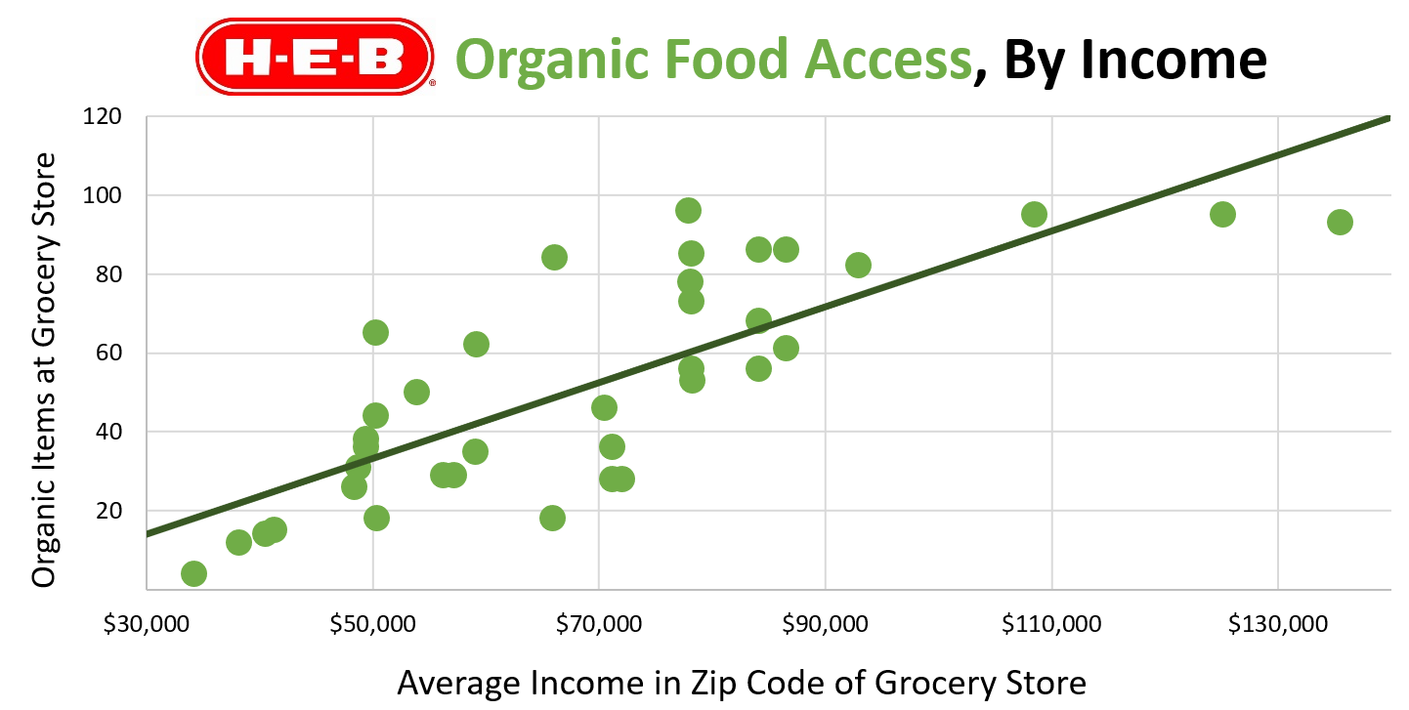
Scatterplot with LSRL

Slide 41
Scatterplot with LSRL
As x increases…

Slide 42
Scatterplot with LSRL
y also increases
As x increases…

Slide 43
Scatterplot with LSRL
y also increases
Direction
Positive
As x increases…

Slide 44
Scatterplot with LSRL
y also increases
Direction
Positive
As average household income increases…

Slide 45
Scatterplot with LSRL
Organic food options increase
Direction
Positive
As average household income increases…

Slide 46
Scatterplot with LSRL

Slide 47
Scatterplot with LSRL

Slide 48
Scatterplot with LSRL
Strength
Moderate

Slide 49
Scatterplot with LSRL
Moderately strong: income is a moderately good predictor of organic options.

Slide 50
Scatterplot with LSRL
Moderately strong: if a new store opened, our model could provide a moderately close prediction of its organic offerings based on neighborhood income.

Slide 51
Describe the relationship…

Slide 52
C
S
O
C
S
One Variable Data:
Dotplots, Stemplots, Histograms, Boxplots

Slide 53
C
S
O
C
S
C
D
O
F
S
One Variable Data:
Dotplots, Stemplots, Histograms, Boxplots
Two Variable Data:
Scatterplots

Slide 54
C – Context
D – Direction (positive/negative)
O – Outliers
F – Form (linear/non-linear)
S – Strength (strong/moderate/weak)

Slide 55
Describe the relationship…

Slide 56
Describe the relationship…
Context: Organic veggies and average income

Slide 57
Describe the relationship…
Context: Organic veggies and average income
Direction: Positive

Slide 58
Describe the relationship…
Context: Organic veggies and average income
Direction: Positive
Outliers: No outliers

Slide 59
Describe the relationship…
Context: Organic veggies and average income
Direction: Positive
Outliers: No outliers
Form: Linear

Slide 60
Describe the relationship…
Context: Organic veggies and average income
Direction: Positive
Outliers: No outliers
Form: Linear
Strength: Moderate

Slide 61
Put it all together:
The relationship between average household income and the number of organic vegetables offered at local stores appears to be linear, positive, and moderately strong. There do not appear to be any outliers.

Slide 62
Context
Put it all together:
The relationship between average household income and the number of organic vegetables offered at local stores appears to be linear, positive, and moderately strong. There do not appear to be any outliers.
Form
Direction
Strength
Outliers

Slide 63
Topics
Explanatory and response variable
Describing scatterplots
The correlation coefficient (r)
Correlation and causation

Slide 64
The Correlation Continuum
Graphic inspired by mathisfun.com
Perfect Positive Correlation
Strong Positive Correlation
Weak Positive Correlation
Weak Negative Correlation
Strong Negative Correlation
Perfect Negative Correlation
No
Correlation

Slide 65
The Correlation Continuum
Graphic inspired by mathisfun.com
Perfect Positive Correlation
Strong Positive Correlation
Weak Positive Correlation
Weak Negative Correlation
Strong Negative Correlation
Perfect Negative Correlation
No
Correlation

Slide 66
The Correlation Continuum
Graphic inspired by mathisfun.com
Perfect Positive Correlation
Strong Positive Correlation
Weak Positive Correlation
Weak Negative Correlation
Strong Negative Correlation
Perfect Negative Correlation
No
Correlation
Correlation Coefficient (r): A number between -1 and 1 that tells you the strength and direction of a correlation.

Slide 67
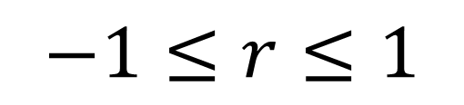
The Correlation Continuum
Graphic inspired by mathisfun.com
Perfect Positive Correlation
Strong Positive Correlation
Weak Positive Correlation
Weak Negative Correlation
Strong Negative Correlation
Perfect Negative Correlation
No
Correlation
Correlation Coefficient (r): A number between -1 and 1 that tells you the strength and direction of a correlation.
$$−1≤r≤1$$
Notes:
R: direction and how strong the relation is.

Slide 68
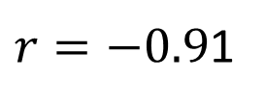






The Correlation Continuum
Graphic inspired by mathisfun.com
Perfect Positive Correlation
Strong Positive Correlation
Weak Positive Correlation
Weak Negative Correlation
Strong Negative Correlation
Perfect Negative Correlation
No
Correlation
$$r=1$$
$$r=0.91$$
$$r=0.48$$
$$r=0$$
$$r=−0.48$$
$r=−0.9$1
$$r=−1$$
Correlation Coefficient (r): A number between -1 and 1 that tells you the strength and direction of a correlation.
$$−1≤r≤1$$

Slide 69
Guide to r values
Strength:
r close to 0 → weak correlation
r close to -1, 1 → strong correlation
Direction:
Negative r value → negative correlation
Positive r value → positive correlation

Slide 70
Scatterplot with LSRL

Slide 71
Scatterplot with LSRL
“Positive”
“Moderately Strong”

Slide 72
Scatterplot with LSRL
r = 0.79

Slide 73
Topics
Explanatory and response variable
Describing scatterplots
The correlation coefficient (r)
Correlation and causation

Slide 74
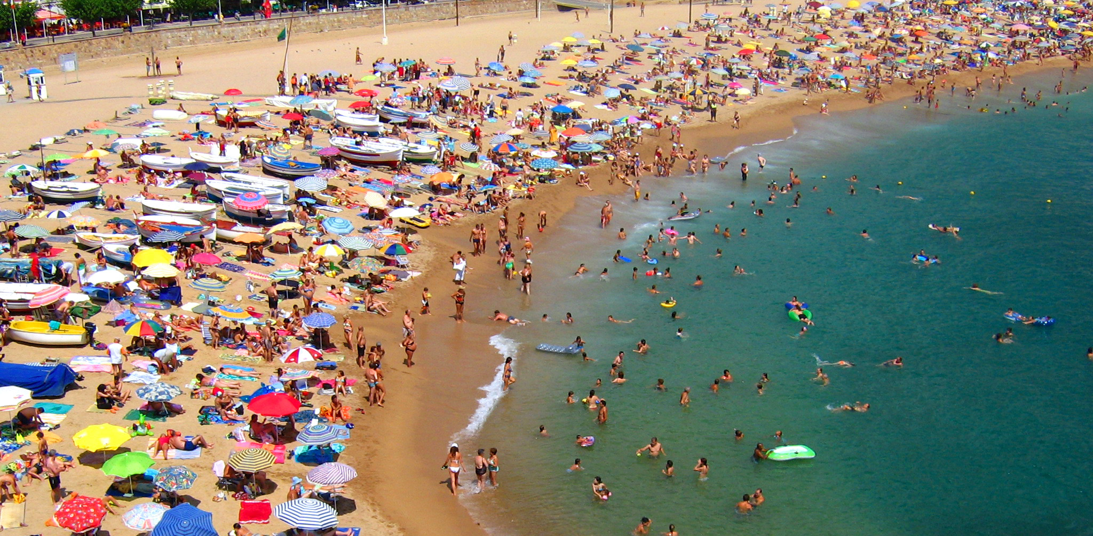
A statistician goes to a beach…
Example inspired by Ionica Smeets: https://www.youtube.com/watch?v=8B271L3NtAw

Slide 75
A statistician goes to a beach…
From 1994-2020, she collected three pieces of data each summer
The average temperature
The amount of ice cream sold at the beach shop
The amount of drownings
Example inspired by Ionica Smeets: https://www.youtube.com/watch?v=8B271L3NtAw

Slide 76
Lesson 3.1
Discussion

Slide 77
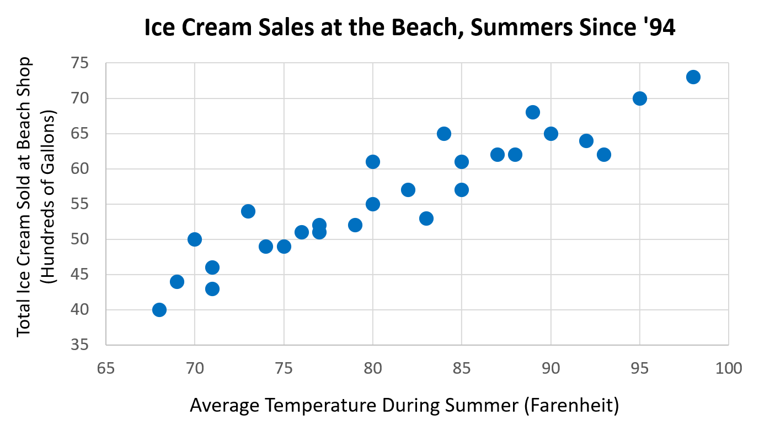
A
Example inspired by Ionica Smeets: https://www.youtube.com/watch?v=8B271L3NtAw

Slide 78
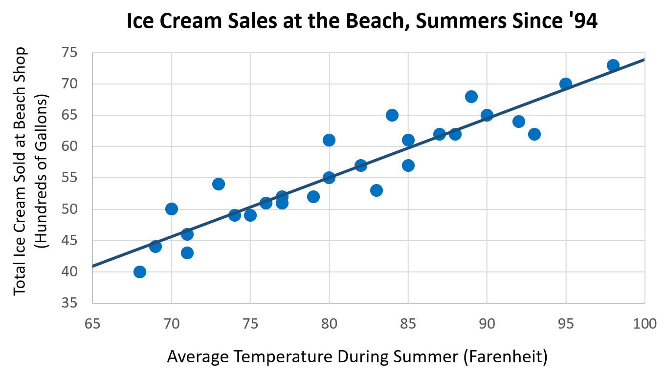
A
Example inspired by Ionica Smeets: https://www.youtube.com/watch?v=8B271L3NtAw

Slide 79
A
A) Discussion Question: Describe the relationship between temperature and ice cream sales. Does this relationship make sense? Why or why not?
Example inspired by Ionica Smeets: https://www.youtube.com/watch?v=8B271L3NtAw

Slide 80
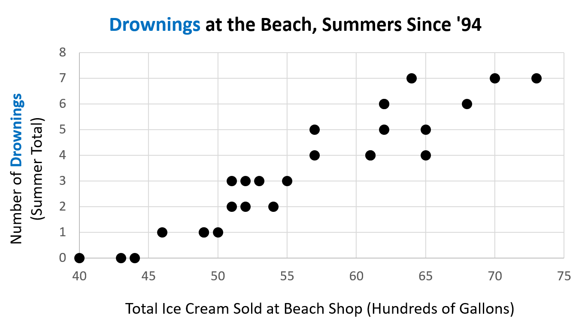
B
Example inspired by Ionica Smeets: https://www.youtube.com/watch?v=8B271L3NtAw

Slide 81
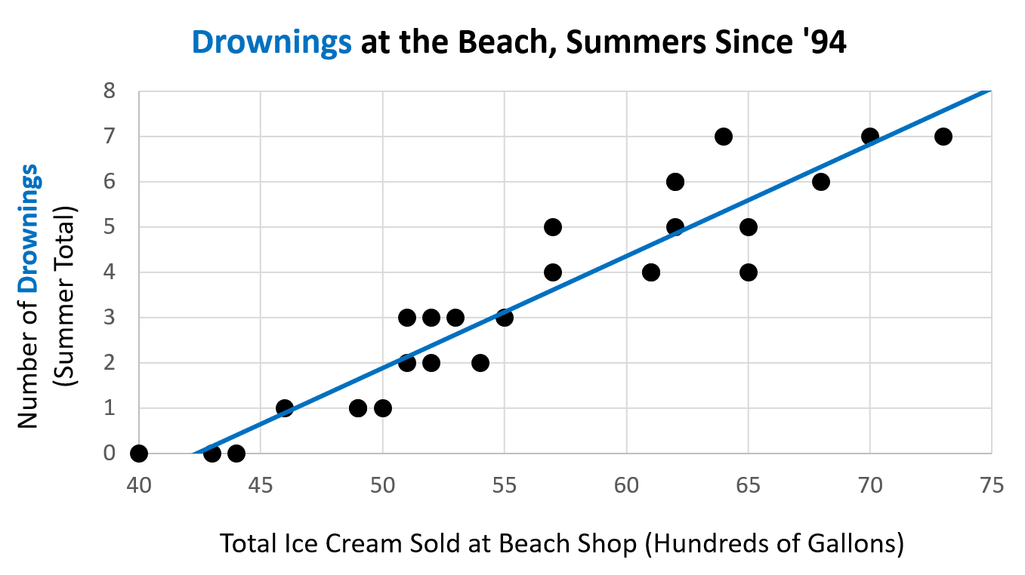
B
Example inspired by Ionica Smeets: https://www.youtube.com/watch?v=8B271L3NtAw

Slide 82
B
B) Discussion Question: Describe the relationship between ice cream sales and drownings. Does this relationship make sense? Why or why not?
Example inspired by Ionica Smeets: https://www.youtube.com/watch?v=8B271L3NtAw

Slide 83
B

Slide 84
B
WE MUST BAN ICE CREAM AT THE BEACH

Slide 85
B
Does ice cream really cause people to drown?

Slide 86
B

Slide 87

B

Slide 88
B
As temp rises…

Slide 89
B
As temp rises…
More people buy ice cream

Slide 90
B
As temp rises…
More people swim and, unfortunately, drown
More people buy ice cream

Slide 91
There is an underlying third variable, temperature, that causes ice cream sales and drownings to coincide.
Ice cream sales and drownings are correlated but do not cause one another.

Slide 92
Correlation ≠ Causation

Slide 93
Sometimes, correlations…
Have an underlying cause (3rd variable)
Cause one another, but not in assumed direction
Are completely random, with no apparent cause

Slide 94
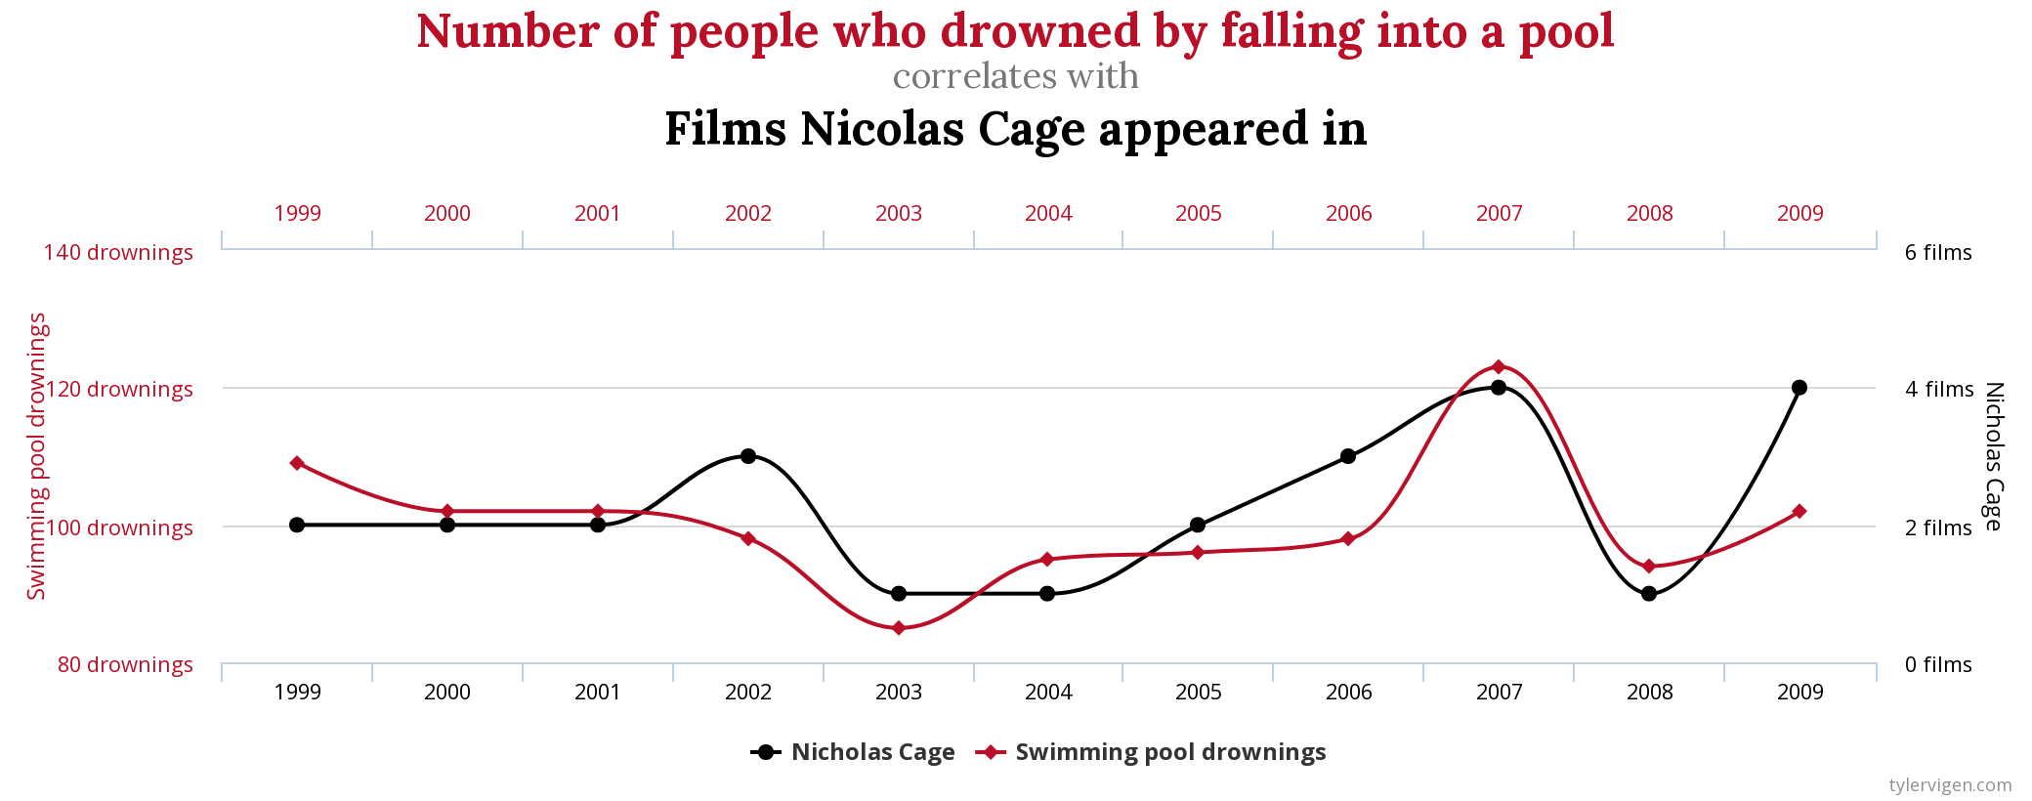
Courtesy of Tyler Vigen: https://www.tylervigen.com/spurious-correlations

Slide 95
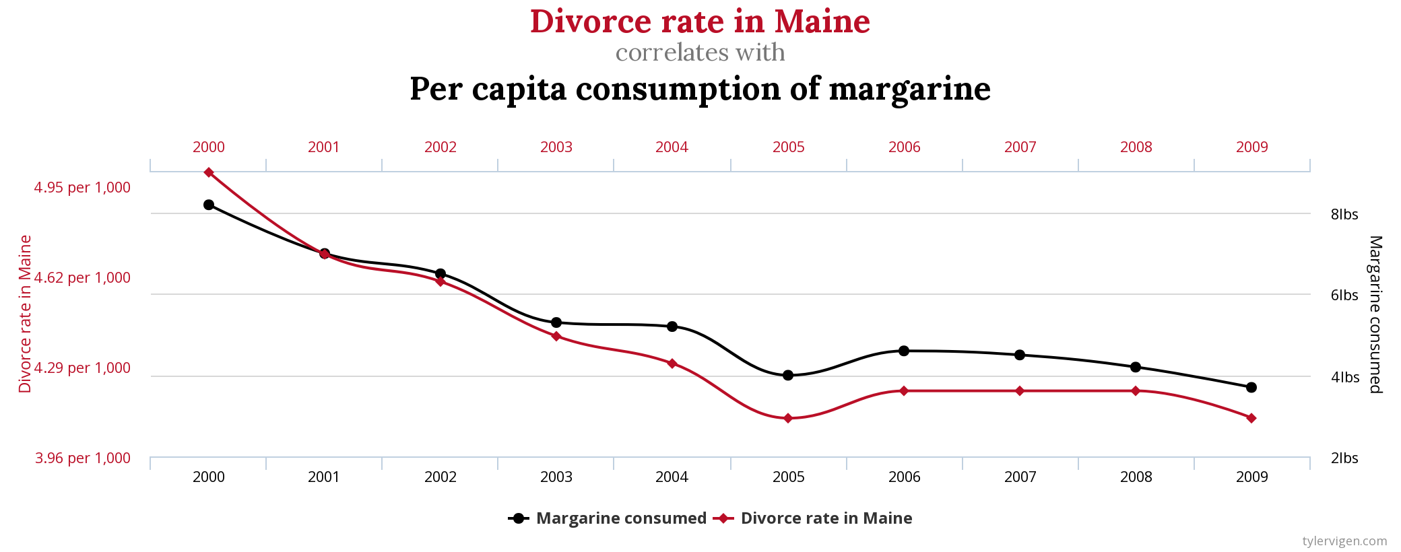
Courtesy of Tyler Vigen: https://www.tylervigen.com/spurious-correlations

Slide 96
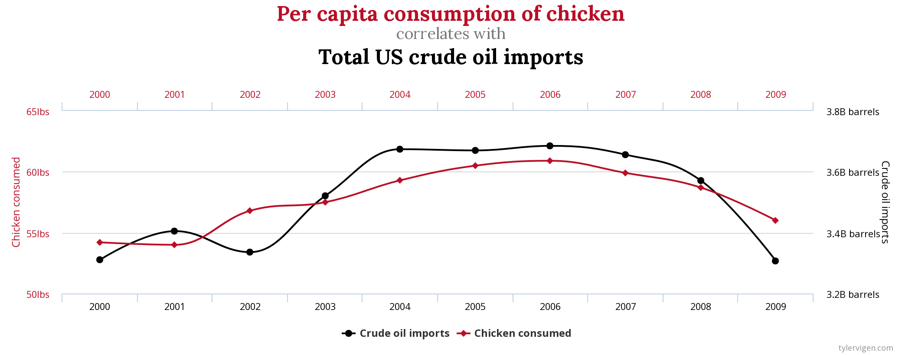
Courtesy of Tyler Vigen: https://www.tylervigen.com/spurious-correlations

Slide 97
Homework

Slide 98
